Slide 2
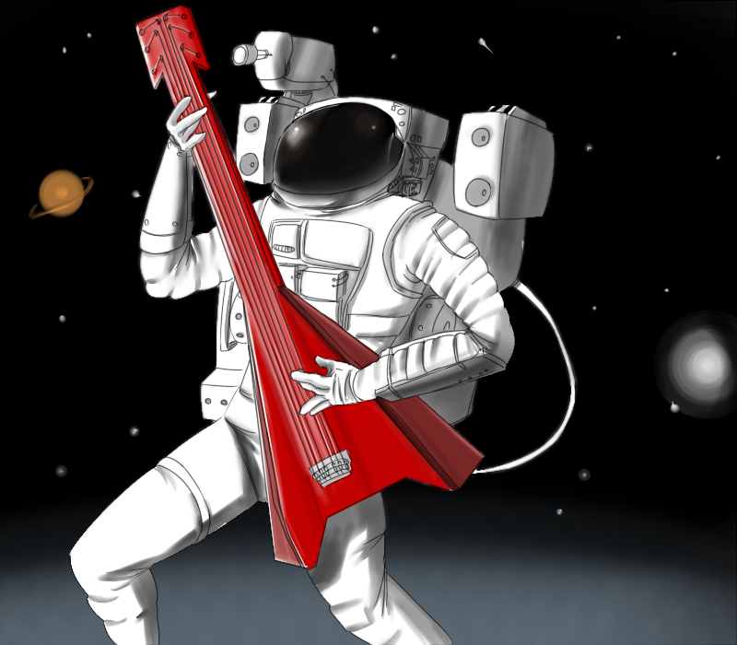
Today!
Sound in Space

Slide 3
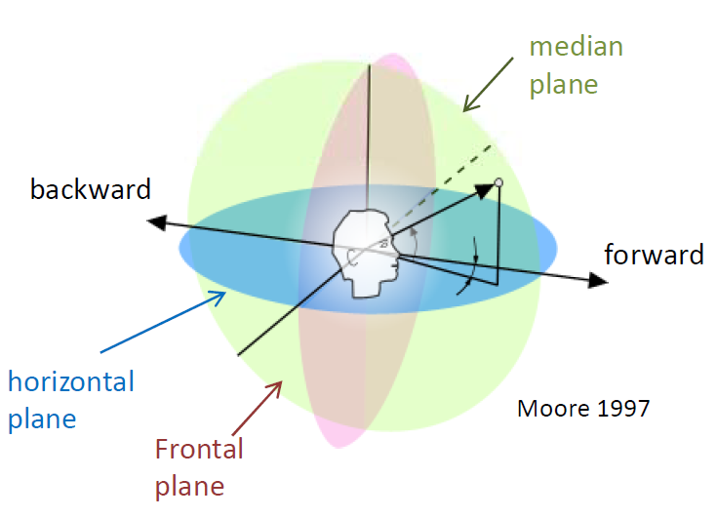
Planes of Auditory Localisation

Slide 4
Binaural Localisation
Topic 1

Slide 5
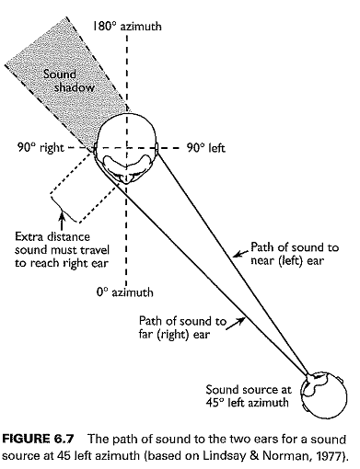
Sound Localisation
Sound waves travel farther to reach the contralateral than the ipsilateral ear, so they arrive later and at a lower level.
Notes:
Contralateral = Opposite side
Ipsilateral = Same side

Slide 6


Interaural Time Difference
0° azimuth
ITD = 0ms
time

Slide 7
Interaural Time Difference
20° azimuth
ITD = 0.15ms
time
time

Slide 8
Interaural Time Difference
60° azimuth
ITD = 0.4ms
time
time

Slide 9
Interaural Time Difference
90° azimuth
ITD = 0.6ms
time
time

Slide 10
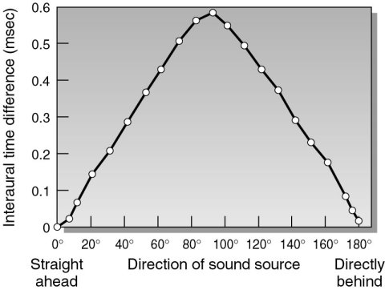
Interaural Time Difference
Speed of Sound = 340m/sec
Head diameter = 0.22m
ITD at 90° =
0.2/340 = 0.00058s
Speed of Sound

Slide 11
ITDs for Different Tone Frequencies
750Hz
Period?
60° azimuth
ITD = 0.4ms
time
time

Slide 12
ITDs for Different Tone Frequencies
750Hz
Period = 1/750 = 0.0013s
1.3ms
60° azimuth
ITD = 0.4ms
time
time

Slide 13
ITDs for Different Tone Frequencies
2000Hz
Period = 1/2000 = 0.0005s
0.5ms
60° azimuth
ITD = 0.4ms
time
time

Slide 14


ITDs for Different Tone Frequencies
Low
30
ITD
20
Cue Effectiveness
Localisation Error (in degrees)
10
High
100 1000 10,000
Frequency (Hz)

Slide 15
Interaural Level Difference
0° azimuth

Slide 16
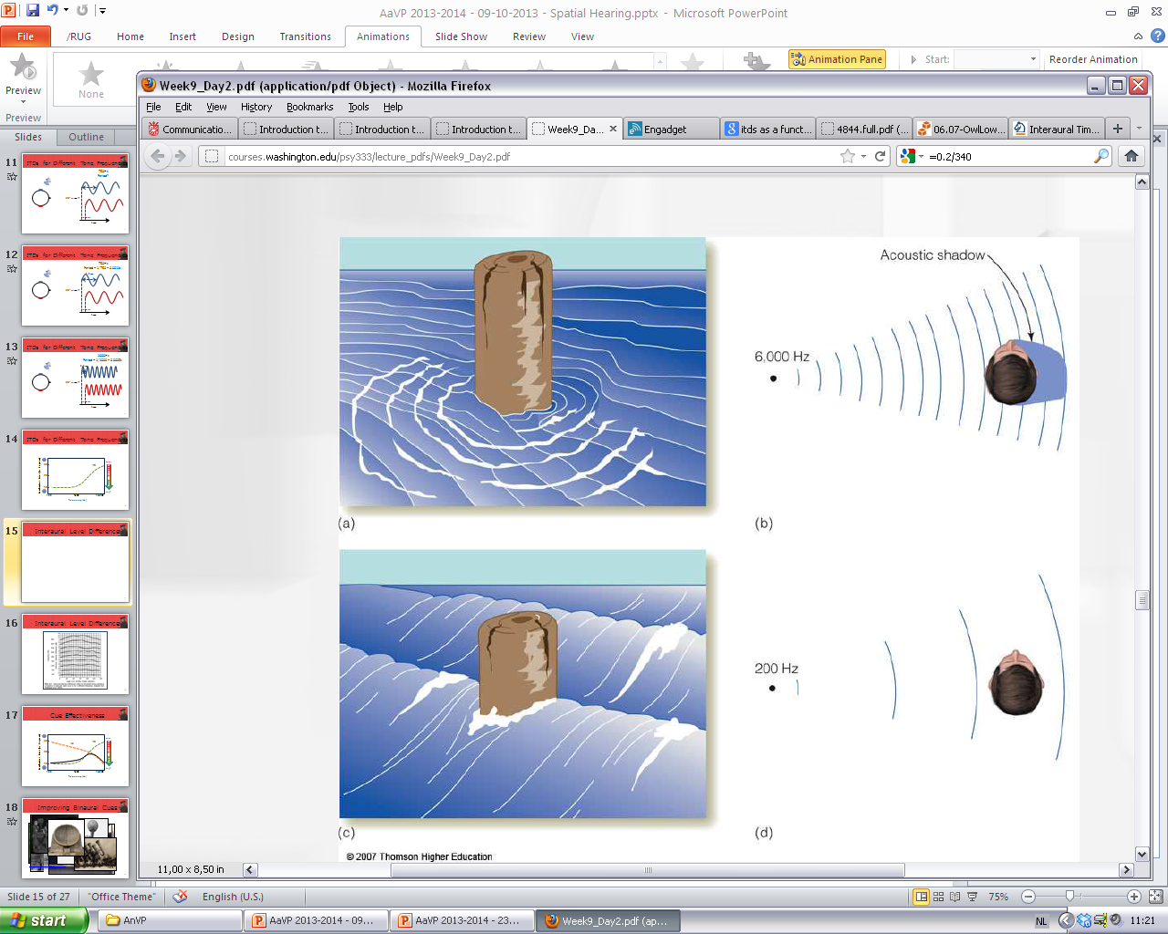
Interaural Level Difference
WHY?
60° azimuth

Slide 17
Interaural Level Difference

Slide 18
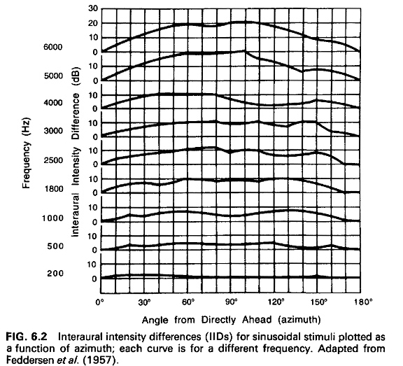
Interaural Level Difference
WHY?

Slide 19
ILDs for Different Tone Frequencies
Wavelength = Distance travelled per cycle

Slide 20
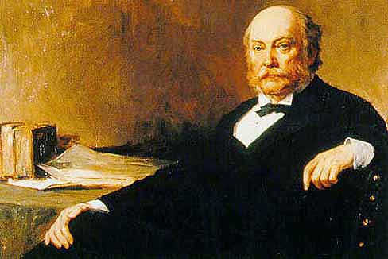
Cue Effectiveness
Low
30
ITD
ILD
20
Cue Effectiveness
Localisation Error (in degrees)
10
High
100 1000 10,000
Frequency (Hz)
John William Strutt, 3rd Baron Rayleigh, OM, PRS
http://archive.org/details/theorysound09raylgoog

Slide 21
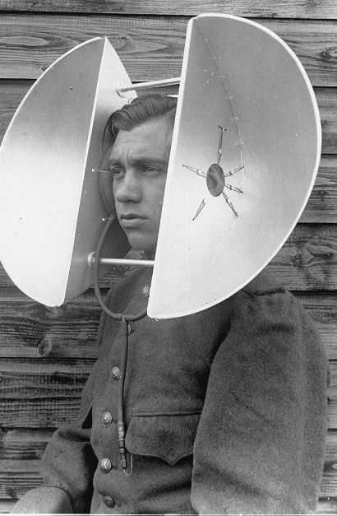
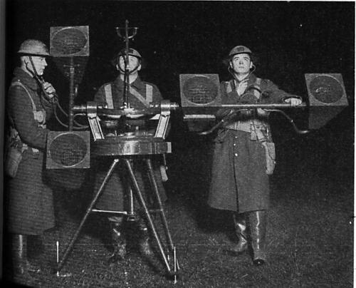
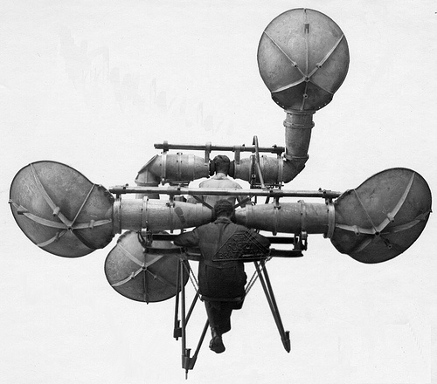
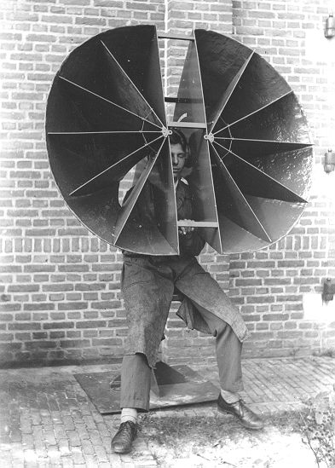
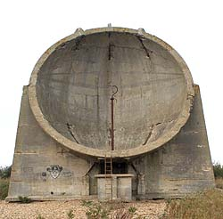
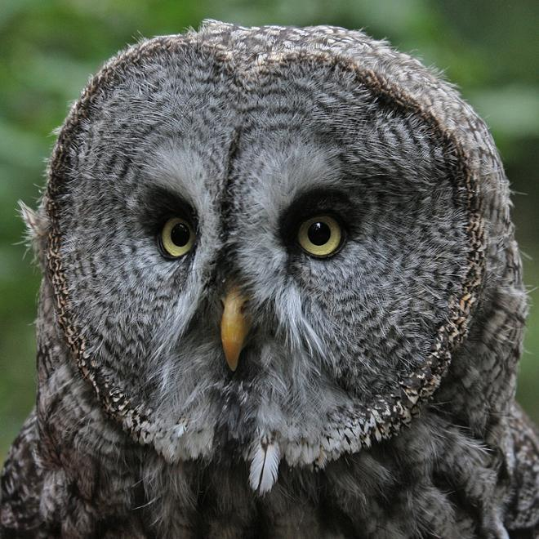
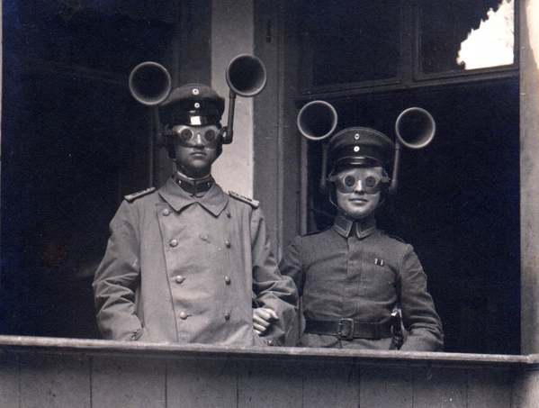
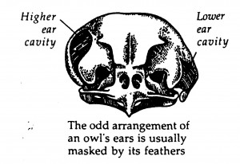
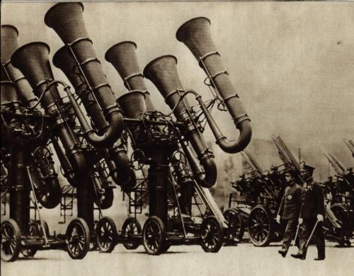
Improving Binaural Cues
http://www.youtube.com/watch?v=yps7pgq1TAk

Slide 22
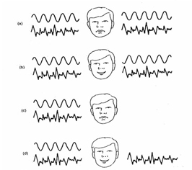
The BMLD

Slide 23
Monaural Localisation
Topic 2

Slide 24
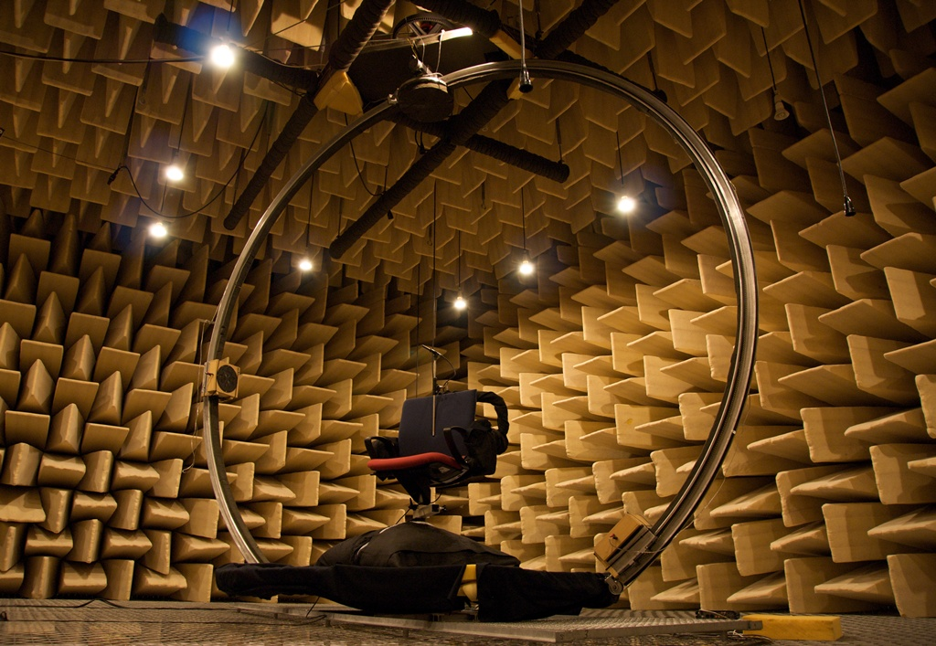
Head-Related Transfer Functions

Slide 25
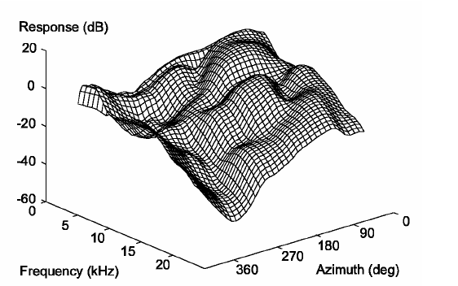
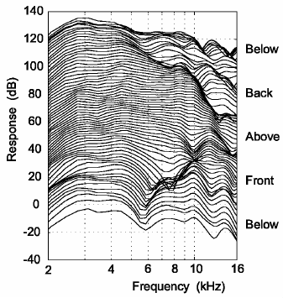
Head-Related Transfer Functions
For virtual auditory space demos, try this: http://www.ece.ucdavis.edu/binaural/
and this: http://interface.cipic.ucdavis.edu/sound/demos/
Notes:
Transfer functions are filter responses (the torso, head, and pinna act as location-sensitive filters)

Slide 26
The Precedence effect
Topic 3

Slide 27
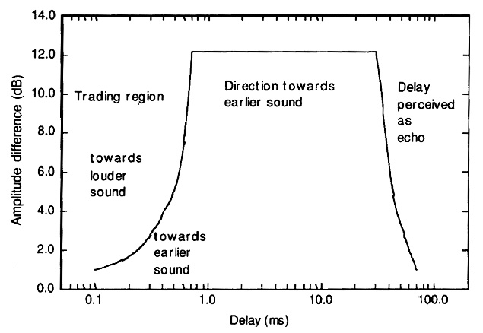
Echoes and The Precedence Effect
Sounds that are separated by less than 35ms (approximately) are fused into a single auditory object located at the source of the earliest sound.

Slide 28
questions?

Slide 29
Thank you!

